Slide 1
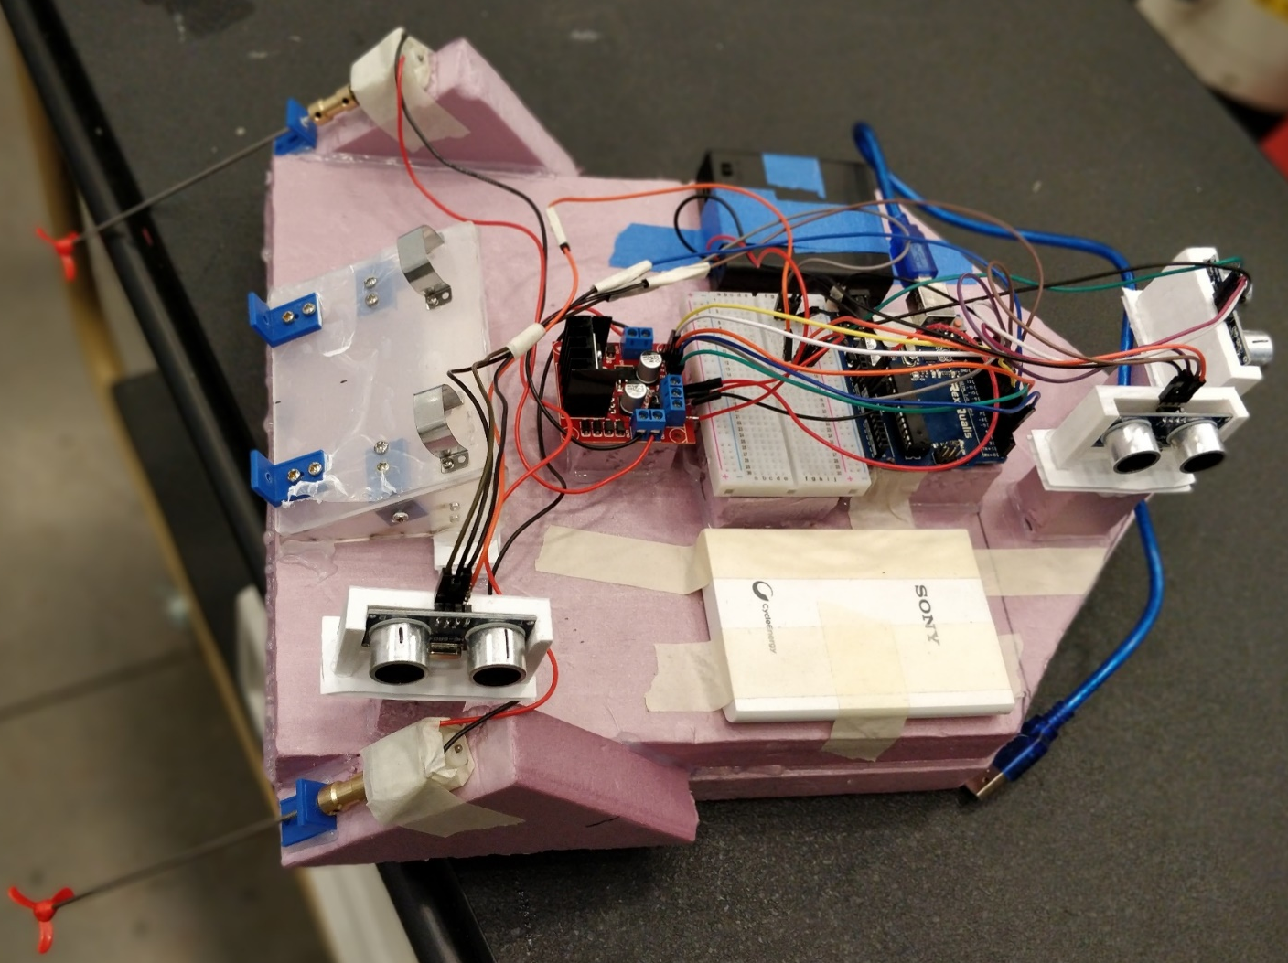
Project 2
Design of a small scale autonomous boat for ocean conservation

Slide 2
Design of the Boat Body & Hardware Setup:
Material Selection:
The criteria to select the material was that it is water proof and could be cut and formed into required shapes. We used corrugated plastic sheet, thermocol and foam board to make boats.
Boat Design:
Initially to decide the size of the boat, we determined a rough layout displaying the placement of the various components.
We decided to design the hull in a curved manner (initial) in order to reduce the drag, improve stability in wavy waters & improve the steering characteristics of the boat.
The foam were cut according to initial drawings & then attached together using a glue gun to form the physical shape of the boat

Slide 3
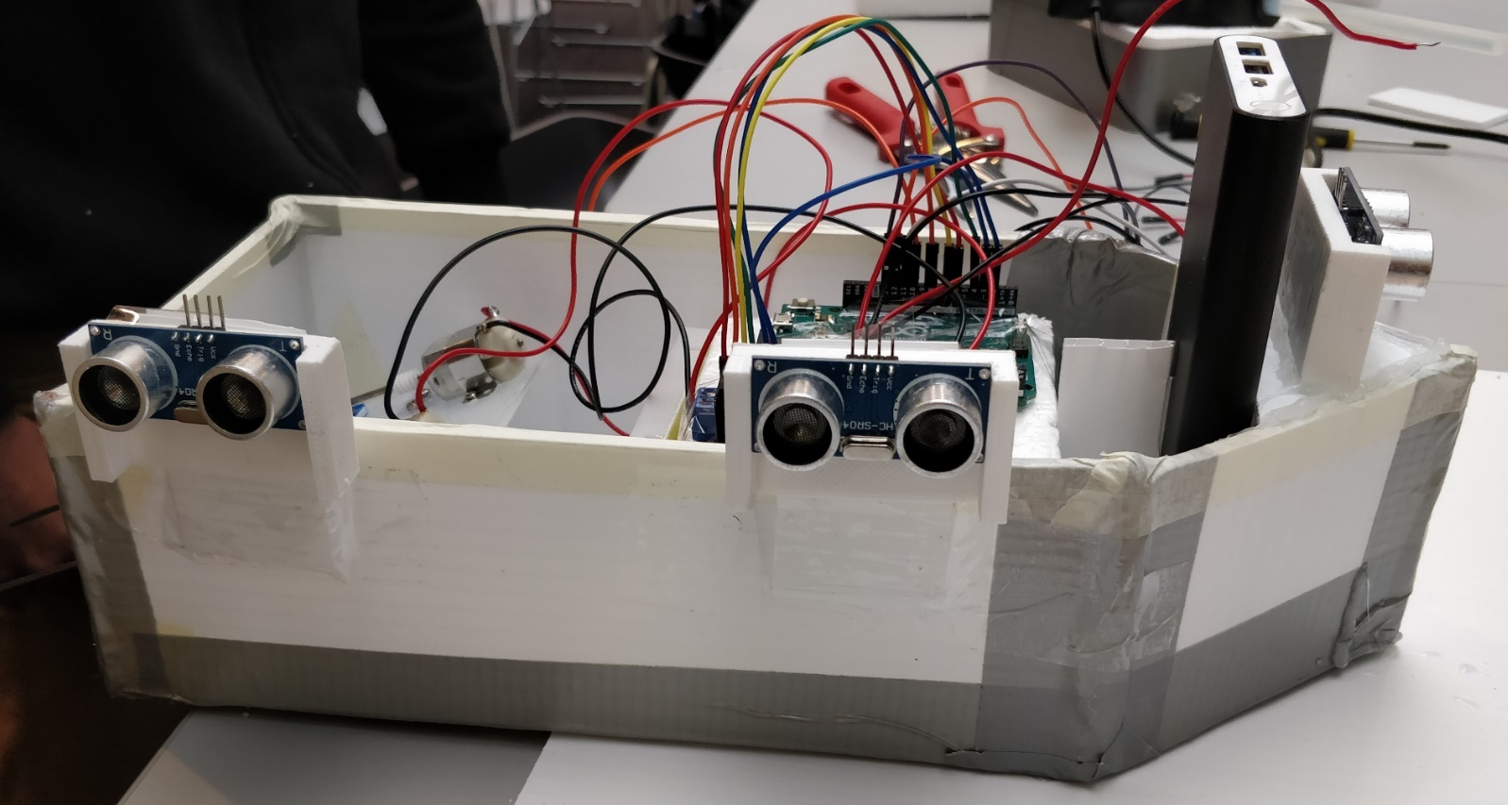
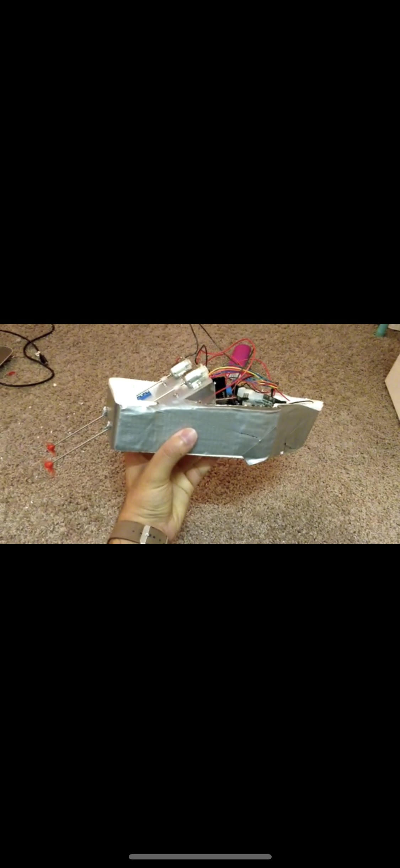
Preliminary Implementation of an Autonomous Boat
1st Iteration
2nd Iteration

Slide 4
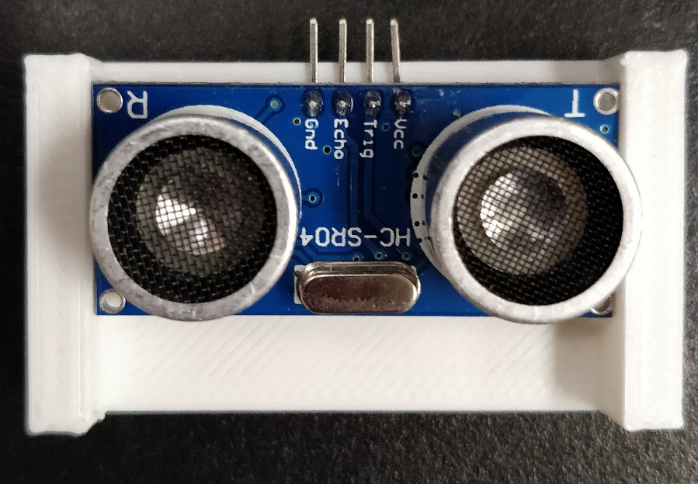
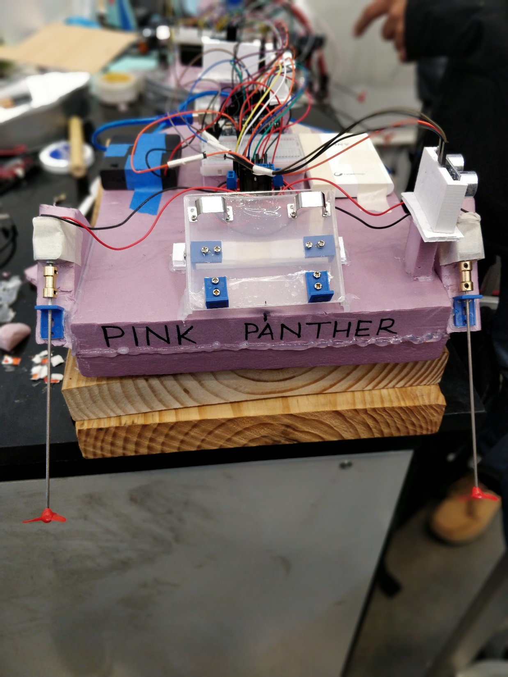
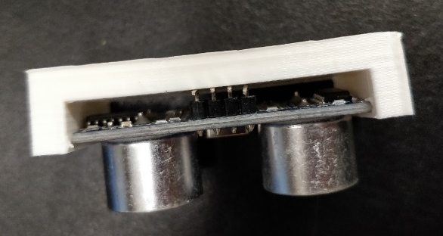
3rd Iteration – Final Boat
3D printed mounts for sensors
Bad Luck to have a boat without a name

Slide 5
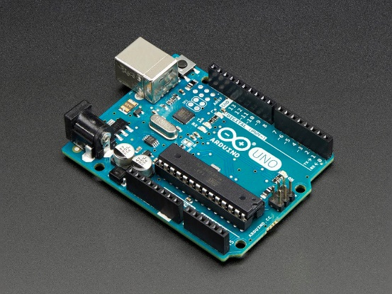
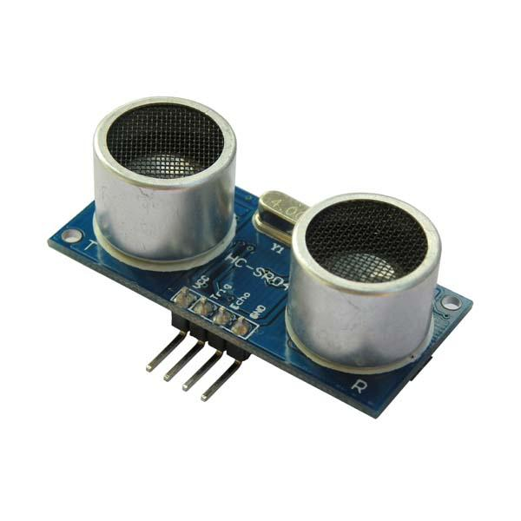
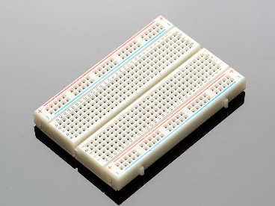
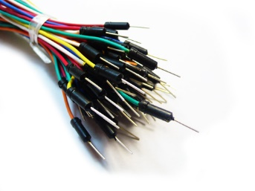
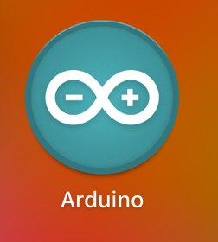
Hardware and Resources
ADD motor control and motor kit

Slide 6
Boat control
The first step was to identify the motor speed bias.
Then a code was developed with simple logic for the boat to complete the course.
The code was optimized to obtain the required motor speed at different conditions.
This code was used as base then to integrate PID.
The set_boat_move function could not be used due to difference in motor speeds. The set_motor_speed function had to be used.

Slide 7
Tuning and Integration of PID
The PID controller tuning was done by following the method of manual tuning:
The value of Kp was set so that a constant oscillating error is obtained
Ki was increased to eliminate the error
kd was set to eliminate the oscillations
After tuning the PID for both sensors the PID function was called into the code to propel and navigate the boat.
The error function was defined using input from the ultrasonic sensors.
Also, during tuning the use of serial plotter and monitor (comparing it with required values) and then running the boat in water saved us a lot of time.

